Slide 1

St. Pete IoT
Brought to you by

Slide 2
St. Pete IoT
Brought to you by
Nicolas Mejia

Slide 3
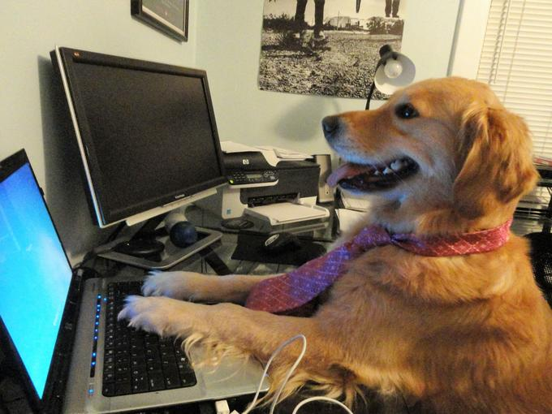
Today’s Agenda
Data and Numbers
Counting
Conversions
ASCII
Digital Logic
Boolean Operators
Operations
Embedded Topics
Operations in C
Lets make a program
Image from knowyourmeme.com

Slide 4
Counting…
0..1..2..3..4..5..6..7..8..9..10
0..1..10..11..100..101..110…

Slide 5
Counting…
00000000
00000001
00000010
00000011
00000100
00000101
00000110
00000111
00001000
00001001….
0..1..2..3..4..5..6..7..8..9..10
0..1..10..11..100..101..110…

Slide 6
Counting…
0..1..2..3..4..5..6..7..8..9..10
0..1..10..11..100..101..110…
0..1..2..3..4..5..6..7..8..9..10..A
A decimal with N digits can represent up to 10^{N} values.
_ _ _ 0…..999
A binary with N digits can represent up to 2^{N} values.
_ _ _ 0…..111
A hex with N digits can represent up to 16^{N} values.
_ _ _ 0…..FFF

Slide 7
Counting…
Decimal example: 578 = 5x(10²) + 7x(10¹) + 8x(10⁰)
Binary example:
101 = 1x(2²) + 0x(2¹) + 1x(2⁰)
Hex example:
FA9 = 15x(16²) + 10x(16¹) + 9x(16⁰)

Slide 8
Counting… (Unsigned)
Index
7 | 6 | 5 | 4 | 3 | 2 | 1 | 0
128 | 64 | 32 | 16 | 8 | 4 | 2 | 1
Bit value
Bits
8 bits can give you any number from 0 to 255

Slide 9
Counting… (Signed)
MSB
Index
7 | 6 | 5 | 4 | 3 | 2 | 1 | 0
-1 | 64 or ? | 32 or ? | 16 or ? | 8 or ? | 4 or ? | 2 or ? | 1 or ?
Bit value
Bits
8 bits can give you any number from -128 to 127

Slide 10
Counting… (Signed)
To make a signed number: If positive do the same as unsigned…
If negative, invert the positive number and add 1
7 | 6 | 5 | 4 | 3 | 2 | 1 | 0
NEG | 64 | 32 | 16 | 8 | 4 | 2 | 1

Slide 11
Counting… (Signed)
To make a signed number: If positive do the same as unsigned…
If negative, invert the positive number and add 1
7 | 6 | 5 | 4 | 3 | 2 | 1 | 0
NEG | 64 | 32 | 16 | 8 | 4 | 2 | 1
0 | 0 | 0 | 0 | 1 | 0 | 0 | 0
0000 1000 → 1111 1000 → 1111 1001 = -8
Invert
+1

Slide 12
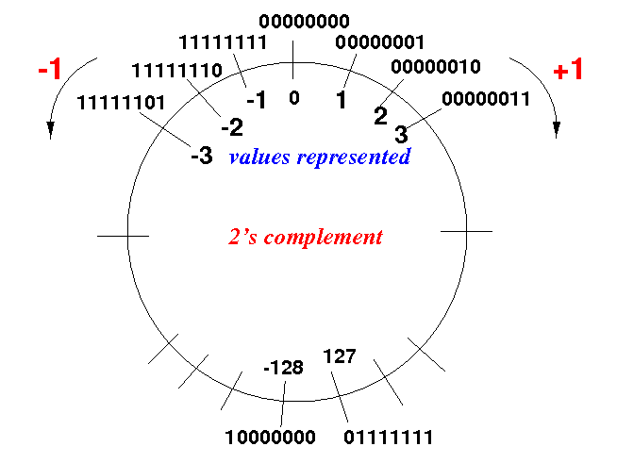
2’s Complement
Image from http://www.mathcs.emory.edu

Slide 13
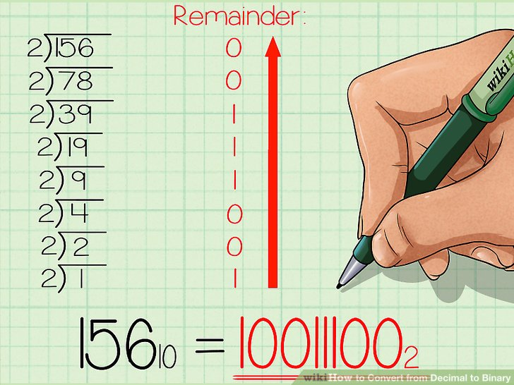
Conversions
Decimal to Binary:
Image from WikiHow.com

Slide 14
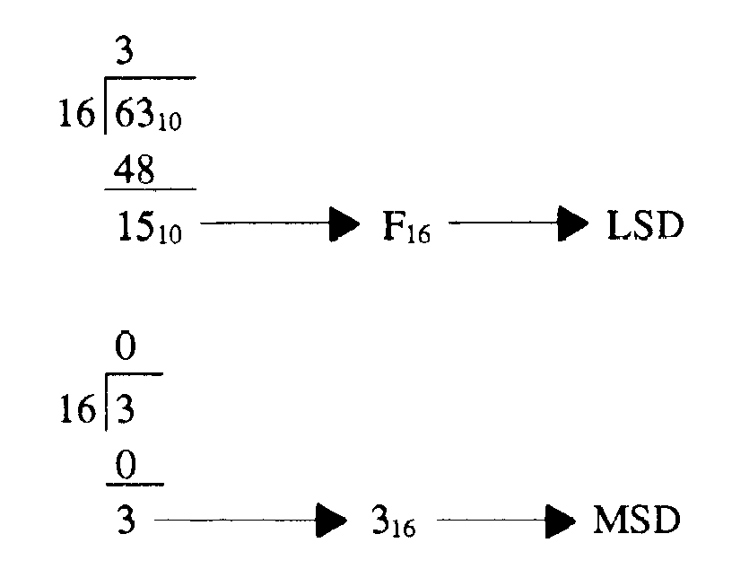
Conversions
Decimal to Hex:
Image from tpub.com

Slide 15
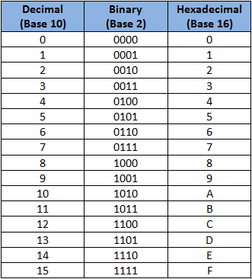

Conversions
Binary $↔$Hex:
0101110101000111
Image from tpub.com

Slide 16
Conversions
Binary $↔$Hex:
0101110101000111
Image from tpub.com

Slide 17
Conversions
Binary $↔$Hex:
0101110101000111
5 D 4 7
Image from tpub.com

Slide 18
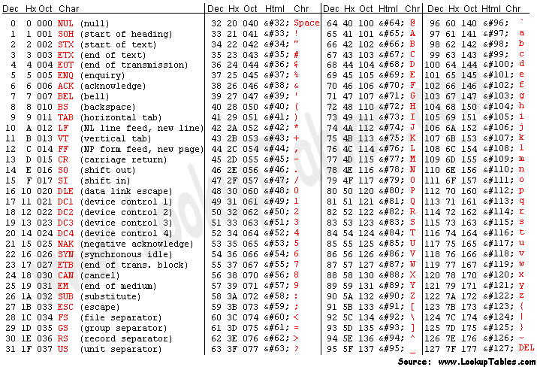
ASCII

Slide 19
Digital Logic
In C
(bit-wise operation)
AND
OR
NOT
XOR
&
|
~
^

Slide 20
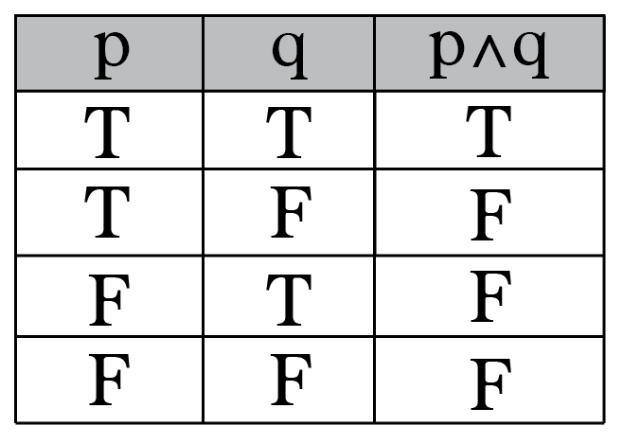
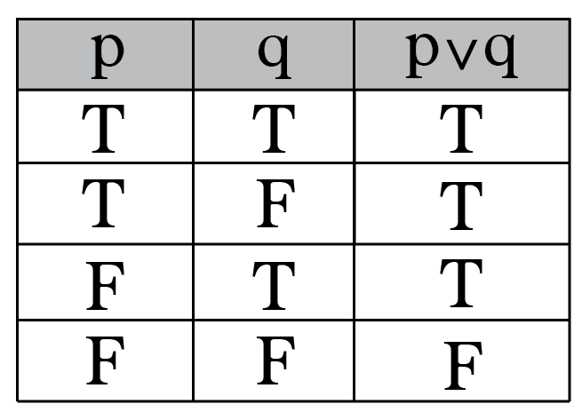
Logic
True = 1
False = 0
&
|

Slide 21
Boolean operators
Possible inputs
A | B
0 | 0
0 | 1
1 | 0
1 | 1

Slide 22
Boolean operators
Possible inputs
A | B
0 | 0 | 0 | 0 | 0 | 0 | 0 | 0 | 0 | 0 | 1 | 1 | 1 | 1 | 1 | 1 | 1 | 1
0 | 1 | 0 | 0 | 0 | 0 | 1 | 1 | 1 | 1 | 0 | 0 | 0 | 0 | 1 | 1 | 1 | 1
1 | 0 | 0 | 0 | 1 | 1 | 0 | 0 | 1 | 1 | 0 | 0 | 1 | 1 | 0 | 0 | 1 | 1
1 | 1 | 0 | 1 | 0 | 1 | 0 | 1 | 0 | 1 | 0 | 1 | 0 | 1 | 0 | 1 | 0 | 1

Slide 23
Boolean operators
Possible inputs
Possible Outputs
A | B |  | & |  | A |  | B | ^ | | |  |  | ~B |  | ~A
0 | 0 | 0 | 0 | 0 | 0 | 0 | 0 | 0 | 0 | 1 | 1 | 1 | 1 | 1 | 1 | 1 | 1
0 | 1 | 0 | 0 | 0 | 0 | 1 | 1 | 1 | 1 | 0 | 0 | 0 | 0 | 1 | 1 | 1 | 1
1 | 0 | 0 | 0 | 1 | 1 | 0 | 0 | 1 | 1 | 0 | 0 | 1 | 1 | 0 | 0 | 1 | 1
1 | 1 | 0 | 1 | 0 | 1 | 0 | 1 | 0 | 1 | 0 | 1 | 0 | 1 | 0 | 1 | 0 | 1

Slide 24
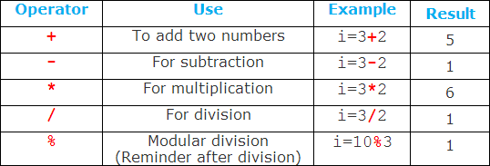
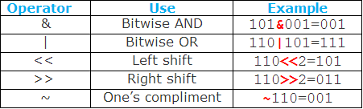

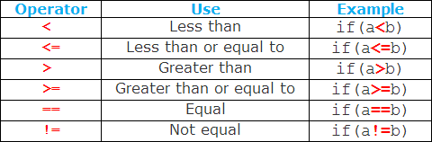
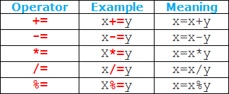
Other operations
Images from unknown source on Pinterest

Slide 25
Links
For Arduino functions and documentation (how to program it)
https://www.arduino.cc/reference/en/ …or google “Arduino API”
For more C tutorials
https://www.tutorialspoint.com/cprogramming/index.htm
For dem slidez (these slides and all content regarding this Meetup)
https://github.com/nico7/IoT-St-Pete

Slide 26
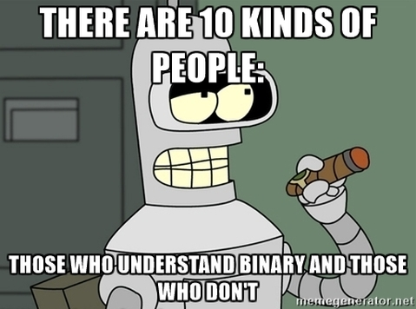
Arduino Exercises
Image from Futurama

